Slide 1
Test-Driven Development
Python

Slide 2
Course Slides
TDD – Test Driven Development

Slide 4
Notes:
Housekeeping and Practical Arrangements
Before we begin, let’s take a moment to cover some practical housekeeping.
Whether you’re attending this workshop online or on-site at your company’s premises, your instructor will guide you through the daily schedule—including start and end times, lunch, and regular comfort breaks—so you’ll always know what to expect.
If at any point during the course you experience any issues—technical, logistical, or related to the course content—please raise them as soon as possible. Early feedback gives us the chance to address the problem and improve your experience. If concerns are only raised at the end in the feedback form, it’s unfortunately too late to do anything about them.
For in-person sessions held at your company’s location, some aspects—such as catering or facilities—may be outside our control. Even so, please let us know and we’ll do our best to help where possible.
We’ll ask for your formal feedback at the end of the workshop. Your input is valuable, and it helps us continue to improve the experience for future participants.

Slide 5

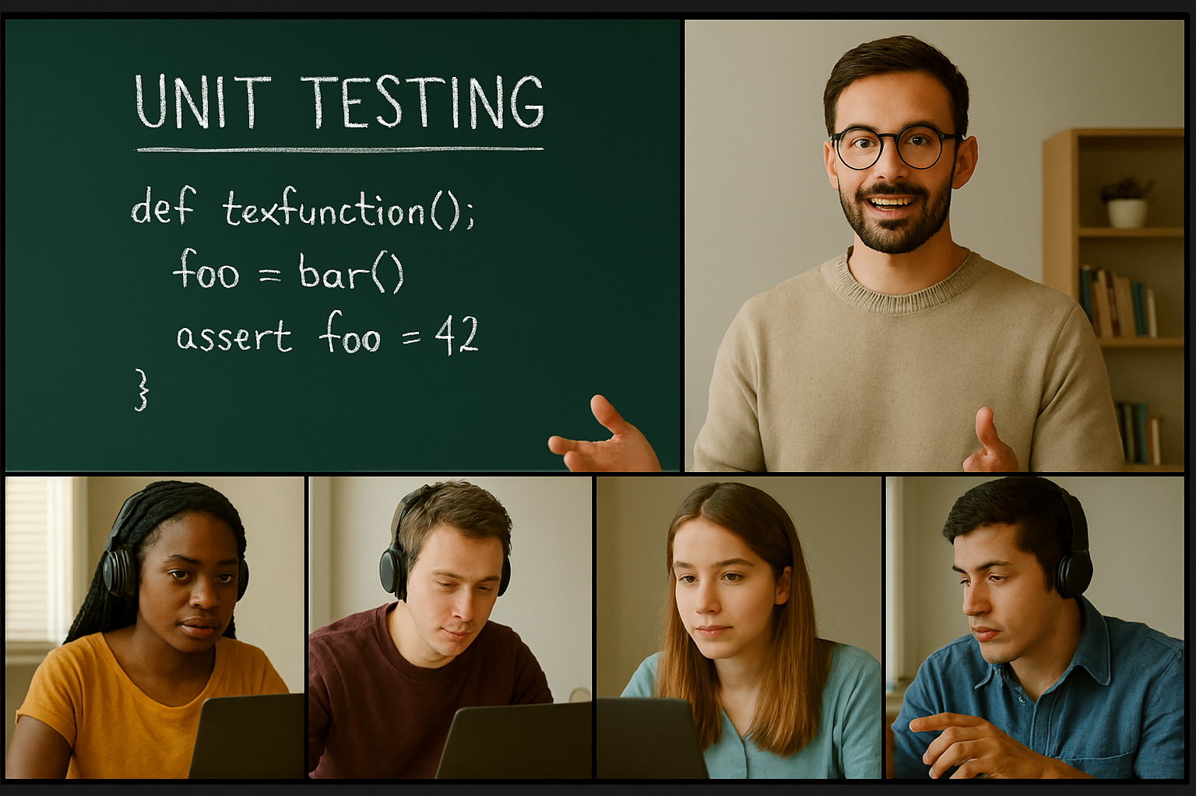




Course Delivery
Hear and forget
See and remember
Do and understand
Notes:
This hands-on workshop is designed to guide participants through a cultural shift towards Test Driven Development (TDD). While we use Python and unit testing as the practical tools, the real focus is on transforming how teams think about and approach software development. Over the course of two days, we’ll explore what it means to work test-first, and how this mindset can lead to more reliable, maintainable, and adaptable code.
The format combines short lecture segments with workbook-based guidance, open Q&A, and focused practical sessions. This balance ensures you can engage with the material actively and reflect on how to apply TDD in your own context.
The structured practical sessions form the core of the workshop. These are designed to help you internalize the TDD workflow by applying it directly to coding tasks and realistic examples. If at any point you’re struggling or unsure, please don’t hesitate to speak up—the instructor is there to support your progress, and it's not always obvious when someone needs help.
By the end of the workshop, you should not only understand the mechanics of testing in Python but, more importantly, begin to adopt a test-first approach as a default mindset in your development work.

Slide 6
Your Training Experience
A course should be:
A two-way process
A group process
An individual experience
Hands-on
Engaging
There is no such thing as a stupid question!
Even when asked by a trainer!
A Question never resides in a single mind!
Keep Webcams ON
Notes:
This workshop is designed to be interactive, practical, and engaging—not a lecture-heavy session with the instructor talking at you all day. You’re encouraged to ask questions, share insights, and take part in discussions. A two-way dialogue makes the experience richer for everyone. If you have lots of questions, the instructor may suggest parking some for offline discussion to keep things flowing for the group.
During practical sessions, you’ll often work in breakout rooms or small groups. Collaboration is encouraged—help each other out, share ideas, and learn from one another. Just remember the goal is to support, not shortcut, each other's learning.
At the same time, we all learn differently. Some participants work quickly, others prefer to go deeper into a particular topic. That’s perfectly fine. The exercises are designed to give you hands-on time with the material, not to be rushed through. You’re free to spend more time on what interests you most.
If you finish early, feel free to explore beyond the exercises—this is a rare chance to experiment, explore, and hack around without the usual day-to-day interruptions. Make the most of it!

Slide 7
By the end of the course, you will be able to:
Appreciate the problem TDD is trying to solve
Appreciate the difference between a test after and test before approach in software development
Improve the test coverage in your code
Develop production code following a TDD approach
Write a Unit Test in Python
Specify a good and bad unit test
Understand the relationship between a unit test, the class under test, and the dependants to the class under test
Work with Stubs
Work with Mocks
Use Unit Tests and Test Doubles in a TDD cycle
Understand what Mutation Testing is

Slide 8
Pre-requisites
This course assumes the following prerequisites:
You have a basic knowledge of Python development
You have a basic knowledge of OOP
You have used an IDE like Pycharm or VSCode
If there are any issues, please tell your instructor now

Slide 9
Introductions
Please say a few words about yourself:
What is your name and job?
What is your current experience of:
Python (rate 0-5)?
Programming (Other Languages)?
Testing (Have you written a Unit Test)?
What is your main objective for attending the course?

Slide 10
TDD
Test Driven Development

Slide 11
What’s the problem?
Most developers who use a testing framework follow this pattern
Write production code (maybe all of the code)
Think how they are going to test it
Write tests with no real understanding of how they can achieve full test coverage
Tests might simply be printouts to standard out, so no real regression is possible
Test what they think works
Test areas of the code that they are not sure if it functions as expected
Tests are not seen as a way of documenting their software
Tests are not seen as a tool for instilling confidence in their code

Slide 12
TDD is an Approach and Philosophy
Tests can:
Act as documentation
Create a framework for developing new code with confidence
Create a framework for modifying existing code with confidence
Create a framework to help improve the design of your code
A test-first driven approach is all of the above and:
A tool for increasing test coverage
A more robust approach to developing new code and modifying existing code

Slide 13



Tests to Development
The software industry didn’t invent the idea of tests first, development after (TDD).
Like most ideas in software (patterns, interfaces, etc.) they come from real-world systems.
There is a lot that can be learned from how other industries inject quality into their systems, and tests before development is one of those good practices.
It may sound like a crazy idea but look at the images on the right. A measure of quality is established before the production of any of those items.
Whether it be food, semiconductor parts, or parts
for cars, etc., quality has to be built into the processes

Slide 14
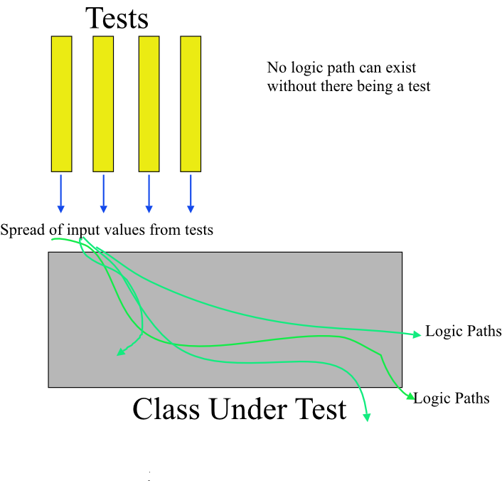
Tests Coverage
Test before approach
If no production code can exist without a corresponding test, then you should be able to achieve 90-100% coverage.
If you only write enough production code to pass a test, then all logic is covered.
Many organisations have policies of not testing setters and getters.
Leads to an improved quality of tests because you test what is actually there.

Slide 15
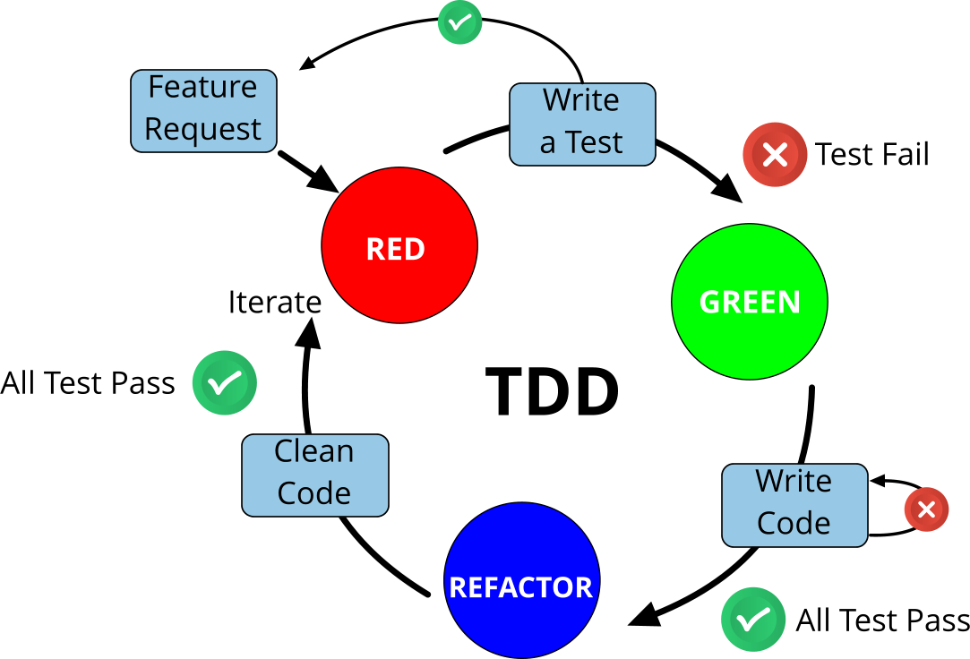
TDD Lifecycle
Feature Request
Write a test
Write just enough code to pass the test
When test passes, push code to repo
Refactor code if needed
Ensure tests are still passing
Push code to repo

Slide 16


Source of Test Data
Consider the following scenario:
You are part of a consultancy working with the government (UK), a rail infrastructure management team (NR), and the construction companies that maintain and build the rail infrastructure.
Your company helps to coordinate the three parties above.
NR and the construction companies purchase components from other companies further down the chain.

Slide 17

Upgrade Scenario
Birmingham to London
New track
New route
Must accommodate
New high-speed rolling stock
Engines and carriages
Old tracks would buckle under new rolling stock.

Slide 18

Hierarchy of Commands
The government mandates certain requirements on the rail industry.
NR interprets those requirements and ensure that they are delivered by the tier 1 construction firms.
NR may also add other requirements to the mix based on their experience and knowledge of the industry.
NR and tier 1 construction companies work with component providers to decide on the components required to meet the requirements.
Government
Requirements
Network Rail (NR)
Interpretation of Government
Requirements, plus
additional Requirements
Tier 1
Construction
Firms
Deployment
of the
requirements
Component
Providers
Creation of
components

Slide 19
So where is the Unit Test?
If there is a trackside problem who is responsible for fixing it?
Government?
NR?
Tier 1 companies?
Component providers?
In software, TDD traditionally sits at the software component level
Government
Requirements
Network Rail (NR)
Interpretation of Government
Requirements, plus
additional Requirements
Tier 1
Construction
Firms
Deployment
of the
requirements
Component
Providers
Creation of
components

Slide 20
Structure of Tests
Tests can come in many forms
Acceptance criteria statements
Spec by example
Truth tables
All of the above can be defined as state testing
As a software engineer, you have to find a way to get those test values into the tests you are writing for your classes/components
There is no magic bullet

Slide 21
Quicklabs – TDD Walkthrough
String Tokeniser
You will develop a small program that accepts a comma-delimited string of tags. Each tag may consist of characters, numbers, and certain symbols (e.g., \$£%&), but not commas. The program should return a list of tags, adhering to the following rules:
Leading and trailing commas must be removed.
Leading whitespace before the first tag and trailing whitespace after the last tag must be trimmed.
Any contiguous sequence of words separated by spaces and ending with a comma should be treated as a single tag.

Slide 22
Quicklabs – TDD Lifecycle
QL-2 TDD
UK Car Registration Plates [In Exercise Guide]

Slide 23
TDD Takeaways
TDD comprises a series of unit tests
You need to work with a source control platform
We follow a RED, GREEN, REFACTOR strategy
Write a test (it’s failing – RED)
Write only enough production code to pass the test (it passes – GREEN)
Don’t write any more code than is required to pass the test
When a test passes, commit your code to a source control repo
If you need to refactor the code, do so, but ensure tests are still passing, then push your code to a source control repo
Move on to your next test
Add tests incrementally. If you don’t, you won’t know which piece of production code is causing a test to fail

Slide 24
Quicklabs – TDD Case Study
QLC-1 - Highest Number Finder
Given the following specification:
If the input were [4, 5, -8, 3, 11, -21, 6] the result should be 11
An empty list should throw an exception
A single-item list should return the single item
If several numbers are equal and highest, only one should be returned
If the input were [7, 13] then the result should be 13
If the input were [13, 4] then the result should be 13
Note: The most challenging part is determining which test to write first. Always start simple, with a test that does not need to handle exceptions.

Slide 25
Anatomy of a Unit Test
Structure of a Unit Test
Do’s and Don’ts of good Unit Tests

Slide 26
Recall our 1st Test Method
class TestHighestNumberFinder(unitest.Testcase):
def test_find_highest_in_list_of_one_expect_single_item(self):
# Arrange
numbers = [10]
cut = HighestNumberFinder()
expected_result = 10
# Act
result = cut.find_highest_number(numbers)
# Assert
self.assertEqual(expected_result, result)

Slide 27
Qualities of a Good Unit Test
Isolated – does not depend on any other unit test.
Comprises of the three A’s:
Arrange
Act
Assert
The object being tested is usually named as the CUT
Does NOT perform (must use test doubles instead!):
IO
Network calls
DB Access
Quick – the tests execute in milliseconds.
A
A
A
CUT

Slide 28
Implementation Class
class HighestNumberFinder:
def find_highest_number(self, numbers):
“””
Returns highest number from the list.
Assumes the list is not empty and
Contains only integers.
“””
return numbers[0]
Only write enough implementation code to pass the test
Do not attempt to write other pieces of code for tests that you have not implemented yet; this maintains your high-test coverage
Writing more code than is required to pass the test means you now have untested code, which will reduce your test coverage
Only write what is needed to maintain good test coverage

Slide 29
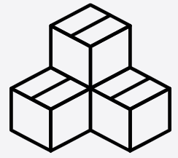


Relationship between Unit Test, CUT and its Dependents
invoke
response
Unit
Test
CUT
Unit Test is testing the CUT
NOT the dependants
And is called Black Box Testing
Dependants, required to support the CUT, use Test Doubles

Slide 30
Relationship between Unit Test, CUT and its Dependents
invoke
response
Unit
Test
CUT
Unit Test is testing the CUT
NOT the dependants
And it is called White Box Testing
Dependants, interaction testing, use mocks and spies
30

Slide 31
Extended Lab – Find Highest Number
A requirement has come through that the highest number finder must deal with finding the highest number for a series of subjects being taught.
You might be tempted to butcher the HighestNumberFinder class. But this would break the tenets of clean code
Single responsibility
Cohesive
It would be better to design the code as follows
<<uses>>
TopicManager
HighestNumberFinder

Slide 32
QuickLab - Working with Dependents
QLC-2.1 TDD Case Study
Topic Manager
Find the highest score for a series of topics
Given the following specification
If the input is [[“Physics”, [56, 67, 45, 89}]], the result should be [[“Physics”, 89]]
If the input is [] the result should be []
If the input is [[“Physics”, [56, 67, 45, 89]], [“Art”, [87, 66, 78]], the result should be [[“Physics”, 89], [“Art”, 87]]
If the input is [[“Physics”, [56, 67, 45, 89]], [“Art”, [87, 66, 78]], [“Comp Sci”, [45, 88, 97, 56]]], the result should be [[“Physics”, 89], [“Art”, 87], [“Comp Sci”, 97]]
The most challenging part is determining which test to write first.
Always start simple, with a test that does not need to handle exceptions.

Slide 33
Dependents Takeaway
When working with tests, watch out for tightly coupled code, it leads to
Untestable code
Testing more than the CUT in a single unit test

Slide 34
Test Doubles

Slide 35
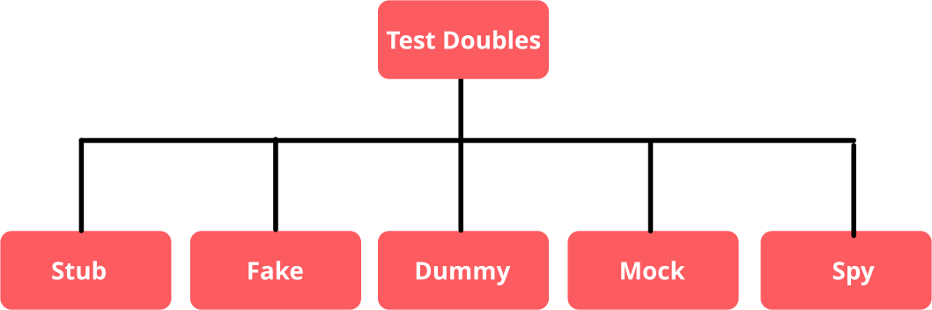
Test Doubles – replace dependencies
Several Types
Ref: https://martinfowler.com/bliki/TestDouble.html

Slide 36
Test Doubles – Design Technique
Good Design Technique:
Improves Code Testability
As well as giving developers the confidence to modify their code base
You may be waiting on code from another developer
Tests are usually executed on build pipelines; they need to be isolated
We want to ensure that our tests are not performing any of the following :
IO
Network calls
DB Access
Tests need to be isolated

Slide 37
Stubs – The Problem
Tight coupling to file I/O
load_file() reads directly from disk, making tests slow, fragile, and environment-dependent.
Difficult to control test inputs
lines is populated internally, you can't inject canned data to test calculate_file_size() independently.
Cannot easily isolate logic
File reading and size calculation are bundled.
Not easily mockable
No parameters passed to _calculate_file_size() - relies on internal state (self.lines) set by file operation.
Violates Single Responsibility Principle
One method responsible for IO and computing size.
def __init__(self, file_to_load):
self.file_to_load = file_to_load
self.lines = []
def load_file(self, fname):
try:
with open(fname, encoding=‘utf-8’) as f:
except IOError:
self.lines = []
return self._calculate_file_size()
def _calculate_file_size(self):
total_length = sum(len(line) for line in self.lines)
return total_length

Slide 38
Stubs – The Solution
class FileLoaderStub:
def __init__(self):
self.file_data = “”
def load_data(self, fname):
self.file_data = “Some random data”
return self._calculate_file_size()
def _calculate_file_size(self):
return len(self.file_data)
No dependency on the file system
load_data() does not touch disk
Test becomes repeatable and fast
no I/O delays or failures
Focus on logic
calculate_file_size() is tested in isolation
Easily controllable input
file_data can be replaced with any string
Simplifies testing
avoids the need to create actual files for the test

Slide 39
QuickLab – TDD Case Study
QLC 2.2 – TopicManager
Introduction to Stubs
A Stub is part of the family of Test Doubles.
They are used to ensure that the tests focus on the behaviour of the CUT and not its dependents.
Test environments should be controlled and predictable.
Test Doubles give you that measure of stability and predictability.
<<uses>>
TopicManager
HighestNumberFinder
Being replaced with a Stub

Slide 40
TDD Takeaway
Having written the tests first, we were able to:
Identify code smells
Perform regression testing easily
Think more clearly about the design of the code
A TDD approach has given you the confidence to modify the code

Slide 41
QuickLab – TDD Case Study
QLC 2.3 – TopicManager
Continue working with Stubs
If the input is [[“Physics”, [56, 67, 45, 89]], [“Art”, [87, 66, 78]], the result should be [[“Physics”, 89], [“Art”, 87]]
One of the tests will fail. Why?
<<uses>>
TopicManager
HighestNumberFinder
Being replaced with a Stub

Slide 42
Stubs Takeaway
When you wrote the other tests, they were failing because the stub was returning the same canned result.
Stubs have their limitations!
You might end up writing a significant amount of code to create a stub test double, which can introduce errors into your tests - as we’ve just seen.

Slide 43
Test Doubles and Verification Testing
Mocks

Slide 44

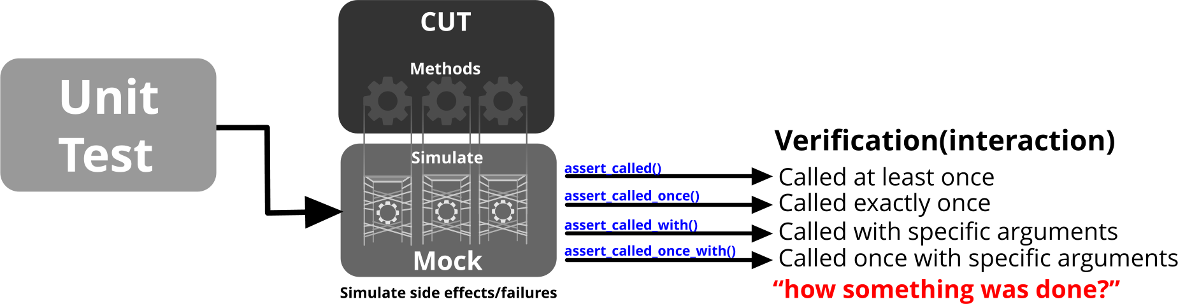
Mock Objects
A mock object is a strongly-typed test double that mimics the interface of the real object it replaces. By default, its methods do nothing and return the default value for their return type. To simulate specific behaviour, you must explicitly configure the mock by 'setting expectations’.
Mocks provide the ‘scaffolding’ but no real structure – they DO NOT run the real code unless explicitly configured to do so. Structure is added through the use of expectations

Slide 45

QuickLab QL-3 Code Demo
Mocks are NOT stubs!

Slide 46
QuickLab – TDD Case Study
QLC 2.4 – TopicManager
Continue working with Mocks
Continuing in a TDD manner, complete the last requirements for the TopicManager class
If the input is [[“Physics”, [56, 67, 45, 89]], [“Art”, [87, 66, 78]], [“Comp Sci”, [45, 88, 97, 56]]], the result should be [[“Physics”, 89}, [“Art”, 87], [“Comp Sci”, 97]]
Use a Mock in place of the production HighestNumberFinder class

Slide 47
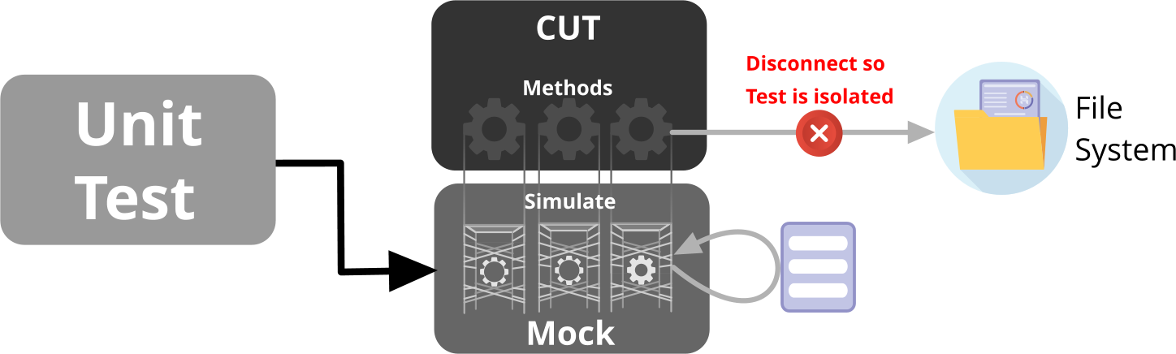
Working with Mocks
We are going to design and refactor our code using a TDD approach and Mocks.
The final CUT will be called FileLoader. It’s job is to load a text file from disk and return the number characters (excluding CR/LF) in the file.

Slide 48
QuickLabs – TDD Demo
QL 4.1 – FileLoader
Write the unit test first for a CUT called FileLoader. It should have only one public method. Once the test is written, develop the CUT to ensure it passes the test.
Question: What’s the weakness in this design?
def load_file(self, fname: str) -> int:
"""
Loads the file specified by fname and returns the
total number of characters.
"""

Slide 49
QuickLabs – TDD Demo
QL 4.2 – Using Lambdas
Create a new unit test that passes a lambda expression to the load_file() method in the class under test (CUT).
Add a new method to the FileLoader class that accepts a callable (e.g., a lambda function) to handle file loading logic.
This allows you to inject a stub function for reading files, improving flexibility and testability.

Slide 50
QuickLabs – TDD Demo
QL 4.3 – Using Stubs
Add a new test that demonstrates passing a lambda to the loadFile() method on the class under test (CUT).
Within the lambda, substitute actual file reading with a list of dummy data — each item in the list should represent a line from a file.

Slide 51
QuickLabs – TDD Demo
QL 4.4 – Replacing the Stub with a Mock
Wrap Python’s built-in open().readlines() in a class method, mimicking the behavior of File.ReadLines().
Use unittest.mock to mock your wrapper class so that its read_lines() method returns dummy data.
Pass a lambda to load_file_with_func() that calls your mocked wrapper’s read_lines() method.

Slide 52
QuickLab – TDD Case Study
QLC 3 – TopicScoreWriter
Working with Test Doubles and Mocks
See Lab Exercise.

Slide 53
Mocking Objects Takeaway
Mocks are not stubs.
Contrary to common thought, they are used to verify the interaction between the CUT and its dependents
Stubs are still valid and should be used when you need to mock the data
Mock objects are a shorthand to creating stubs for mocked data but that’s not their purpose

Slide 54

Spy Object
A spy is a strongly-typed object that replicates the interface of the real object it replaces.
By default, its methods delegate calls to the real object, allowing the actual behaviour to run.
However, if specific expectations or overrides are set on the spy, those will take precedence over the real method
While a mock is just scaffolding with nothing inside, a spy is like scaffolding around a real house—you can still access and use the actual structure unless you cover it with something new.

Slide 55
Untestable Code

Slide 56
What is Untestable Code?
Code that is difficult to test often has one or more of the following characteristics:
Hard to isolate: relies on I/O, networking, or external databases.
Opaque state: it's difficult to verify the internal state after method calls, even when inputs are known.
Inaccessible logic paths: certain paths are only triggered under specific conditions, such as time-based constraints.
Tightly coupled: depends heavily on other components that require complex setup or configuration.
Legacy dependencies: interacts with code you can’t modify or don’t have source access to but still need to rely on.

Slide 57
QuickLab – TDD Case Study
QLC 4 – There is no Lab

Slide 58
Conclusion
TDD is not as complex as it may first seem
Unit tests are ideal for identifying weaknesses in your design
Unit tests combined with a TDD philosophy can really help you design well structured and designed code

